Slide 1

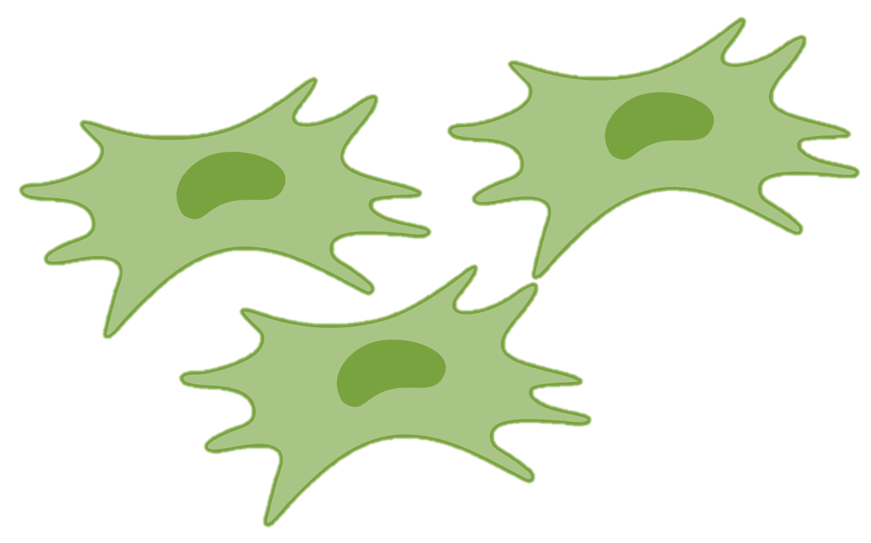
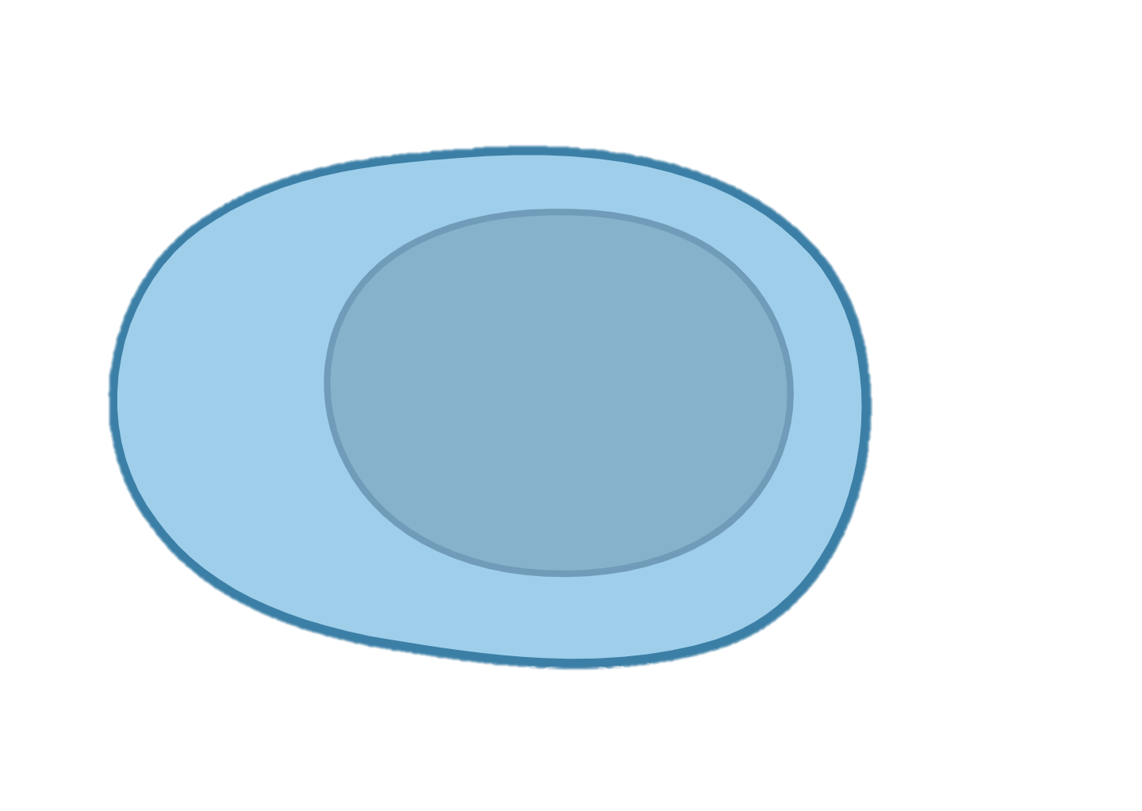

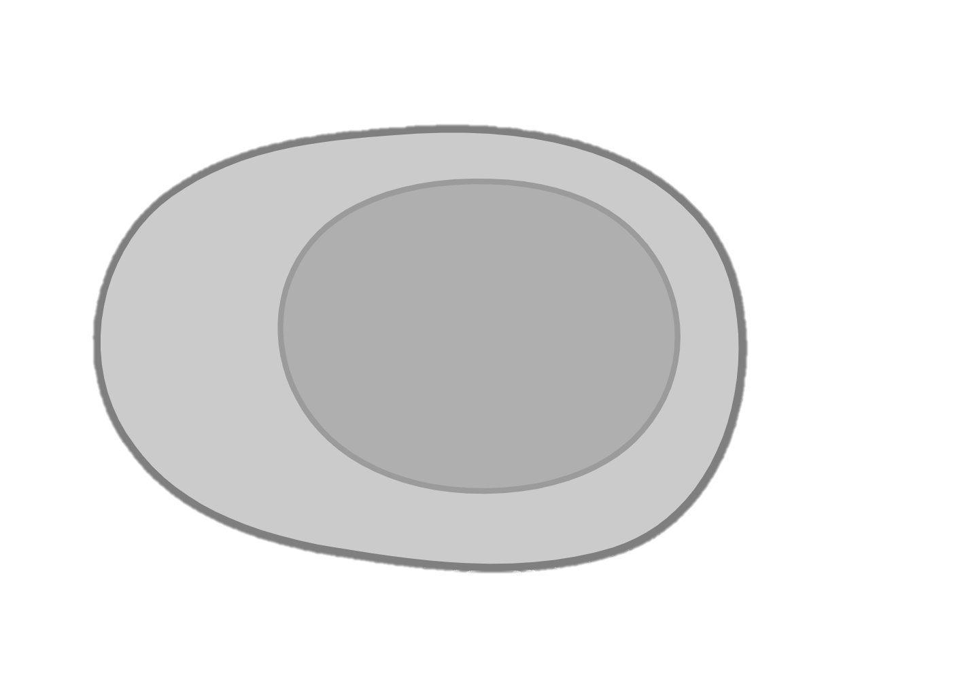
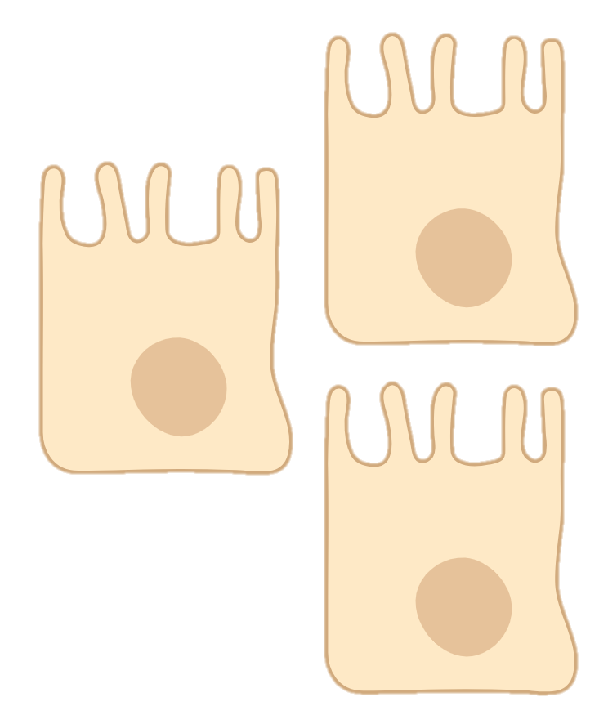
Experiment Design
Untreated (CC)
Mesenchymal cells
Non-Fibrotic group
TGFb (TG)
RNA-seq
TNFa (TN)
iPSCs
Epithelial cells
TGFb+TNFa (TT)
Fibrotic group

Slide 2
Experiment Design
Mesenchymal cells
Untreated (CC)
TGFb (TG)
TNFa (TN)
TGFb+TNFa (TT)
Non-Fibrotic group
iPSCs
Epithelial cells
Fibrotic group

